Slide 1




International Trade of Culture and Sports
A journey through Canada’s Import and Export of Sports and Culture
Group 1

Slide 2
Canadian Culture & Sports, Across Borders.
Canada has played a significant part in exporting its culture and sports products to the world. From Poutine to the NHL, Canada’s place in today’s global economy is unquestioned. But to understand the beating heart of Canada's culture and sports trade, one needs to analyze how it exports its culture and sports influences on the wider global community, and what influences Canada welcomes through its ports as it positions itself uniquely as a hub of global trade.

Slide 3
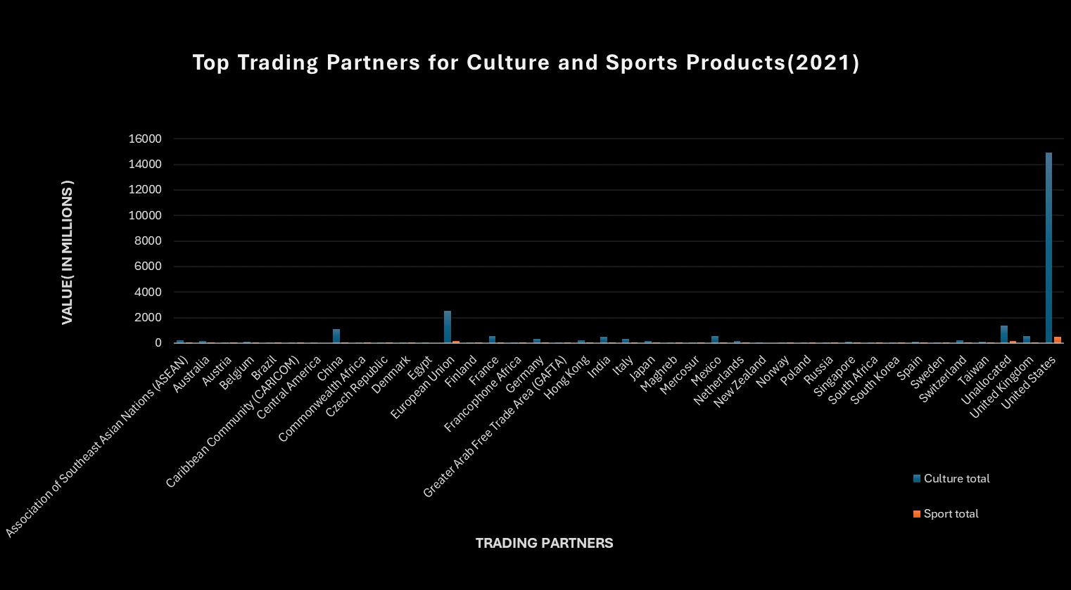
Leading Trading Partner- Import
In 2021 the United States contributed as Canada ‘s most significant trade partner. Amounting to 59.5% of all imports.

Slide 4
Trends in Culture and Sports: Imports vs. Exports
There was a significant increase in both imports and exports during the 2012-13 period, conversely there was also a notable decline in both exports and imports in the period between 2020-21.

Slide 5
Culture Imports: Francophone Africa vs ASEAN Countries
There is a notable disparity between imports from Francophone Africa as compared to ASEAN countries, with the latter being a more significant trade partner. This owes to limited trading infrastructure, and unfavorable economic conditions.

Slide 6
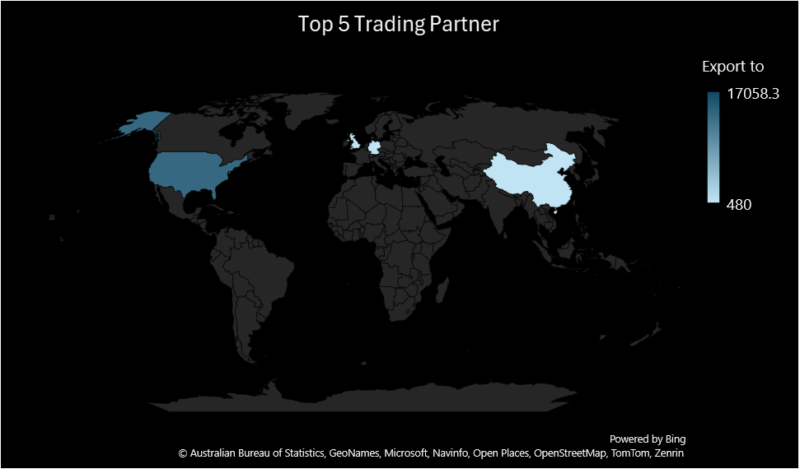
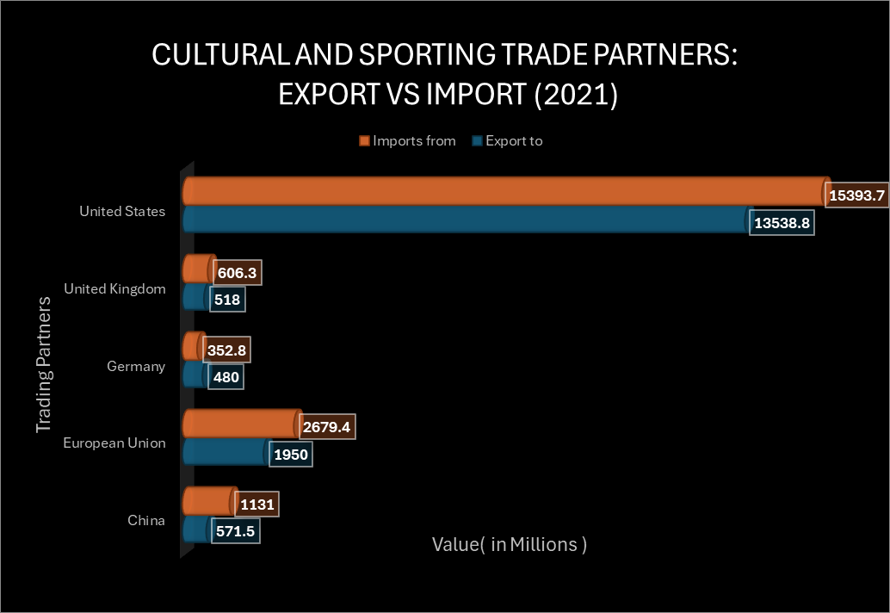
Top 5 Trading Partners in 2021
The United States serves as Canada’s leading trade partner in both imports and exports for the year 2021, followed by the United Kingdom, Germany, European Union countries, and China. It is evident that Canada imports more than it exports as regards these trade partners.

Slide 7
Canada-Australia Trade Balance
We observed a trade deficit from 2020-2021 which means that Canada’s imports exceeded its exports. The decline however begins in 2019 and continues further owing to the Covid-19 pandemic.

Slide 8
Exports in Culture Domain from 2019-21
Collectively through the years 2019-21, the domain that saw the highest growth of exports was visual applied arts.

Slide 9
Exports in Sports Domain from 2019-21
Collectively through the years 2019-21, the domain that saw the highest growth of exports was organized support.

Slide 10
Thank you!
Presented by: Vaibhav Ahuja
Rishab Chakrabarti
Aaron Acheampong-Okyere
Farhan Abbas Abidi
Precious Obianuju Chime

